Slide 1
Chapter 6 – System Modeling
Anh Nguyen-Duc
Tho Quan Thanh

Slide 2
Topics covered
Context models
Interaction models
Structural models
Behavioral models
Model-driven engineering

Slide 3
System modeling
the process of developing abstract models of a system
each model presenting a different view or perspective
means representing a system using some kind of graphical notation
almost always based on notations in the Unified Modeling Language (UML).
helps the analyst to
understand the functionality of the system
use models to communicate with customers.
Notes:
System modeling is the process of developing abstract models of a system, with each model presenting a different view or perspective of that system.
System modeling has now come to mean representing a system using some kind of graphical notation, which is now almost always based on notations in the Unified Modeling Language (UML).
System modelling helps the analyst to understand the functionality of the system and models are used to communicate with customers.

Slide 4
Existing and planned system models
Models of the existing system
used during requirements engineering.
They help clarify what the existing system does and can be used as a basis for discussing its strengths and weaknesses.
These then lead to requirements for the new system.
Models of the new system
used during requirements engineering to help explain the proposed requirements to other system stakeholders.
Engineers use these models to discuss design proposals and to document the system for implementation.
Notes:
Models of the existing system are used during requirements engineering. They help clarify what the existing system does and can be used as a basis for discussing its strengths and weaknesses. These then lead to requirements for the new system.
Models of the new system are used during requirements engineering to help explain the proposed requirements to other system stakeholders. Engineers use these models to discuss design proposals and to document the system for implementation.
In a model-driven engineering process, it is possible to generate a complete or partial system implementation from the system model.

Slide 5
System perspectives
An external perspective
models the context or environment of the system.
An interaction perspective
models the interactions between a system and its environment, or between the components of a system.
A structural perspective
models the organization of a system or the structure of the data that is processed by the system.
A behavioral perspective
models the dynamic behavior of the system and how it responds to events.
Notes:
An external perspective, where you model the context or environment of the system.
An interaction perspective, where you model the interactions between a system and its environment, or between the components of a system.
A structural perspective, where you model the organization of a system or the structure of the data that is processed by the system.
A behavioral perspective, where you model the dynamic behavior of the system and how it responds to events.
These perspectives have much in common with Krutchen’s 4 + 1 view of system architecture, where he suggests that you should document a system’s
architecture and organization from different perspectives.

Slide 6
Use of graphical models
As a means of facilitating discussion about an existing or proposed system
may be incomplete
As a way of documenting an existing system
should be an accurate representation of the system
As a detailed system description that can be used to generate a system implementation
Models have to be both correct and complete.
Notes:
In the first case, the purpose of the model is to stimulate the discussion amongst the software engineers involved in developing the system. The models
may be incomplete (so long as they cover the key points of the discussion) and they may use the modeling notation informally
In the second case, they do not have to be complete as you may only wish to develop models for some parts of a system. However, these models have to be
correct—they should use the notation correctly and be an accurate description of the system.
In the third case, where models are used as part of a model-based development process, the system models have to be both complete and correct. The reason for this
is that they are used as a basis for generating the source code of the system. Therefore, you have to be very careful not to confuse similar symbols, such as stick and block arrowheads, that have different meanings.

Slide 7
UML diagram types
Activity diagrams, which show the activities involved in a process or in data processing .
Use case diagrams, which show the interactions between a system and its environment.
Sequence diagrams, which show interactions between actors and the system and between system components.
Class diagrams, which show the object classes in the system and the associations between these classes.
State diagrams, which show how the system reacts to internal and external events.
Notes:
There are more UML diagrams: collaboration, object, …
A mapping to system perspectives ?
Activity diagram ~ interaction
…

Slide 8
External Perspectives

Slide 9
Context models
To illustrate the operational context of a system – the boundaries
they show what lies outside the system boundaries.
Social and organisational concerns may affect the decision on where to position system boundaries.
Architectural models show the system and its relationship with other systems.
Notes:
Context models are used to illustrate the operational context of a system - they show what lies outside the system boundaries.
Making context (boundary) involves working with system stakeholders to decide what functionality should be included in the system and what is provided by the system’s environment: some should be implemented, but others should be manual or supported by different systems.
These should be made early in the process to limit the system costs and the time needed for understanding the system requirements and design.
Social and organisational concerns may affect the decision on where to position system boundaries.
Architectural models show the system and its relationship with other systems.

Slide 10
System boundaries
System boundaries are established to define what is inside and what is outside the system.
They show other systems that are used or depend on the system being developed.
Notes:
The position of the system boundary has a profound effect on the system requirements.
Defining a system boundary is a political judgment
There may be pressures to develop system boundaries that increase / decrease the influence or workload of different parts of an organization.

Slide 11
The context of the Mentcare system

Slide 12
Process perspective
Context models simply show the other systems in the environment, not how the system being developed is used in that environment.
Process models reveal how the system being developed is used in broader business processes.
UML activity diagrams may be used to define business process models.

Slide 13
Process model of involuntary detention
our system
Notes:
(Wikipedia.org) Involuntary commitment or civil commitment (also known as sectioning in some jurisdictions) is a legal process through which an individual who is deemed by a qualified agent to have symptoms of severe psychiatric disease is court-ordered into treatment in a mental institution (inpatient) or in the community (outpatient).
This model (UML activity diagram) shows the processes in which the MHC-PMS is used. Sometimes, patients who are suffering from mental health problems may be a danger to others or to themselves. They may therefore have to be detained against their will in a hospital so that treatment can be administered. Such detention is subject to strict legal safeguards—for example, the decision to detain a patient must be regularly reviewed so that people are not held indefinitely without good reason. One of the functions of the MHC-PMS is to ensure that such safeguards are implemented.

Slide 14
Interaction Perspectives

Slide 15
Interaction models
Modeling user interaction
helps to identify user requirements.
Modeling system-to-system interaction
highlights the communication problems that may arise.
Modeling component interaction
to understand if a proposed system structure is likely to deliver the required system performance and dependability.
Use case diagrams and sequence diagrams may be used for interaction modeling.
Notes:
Modeling user interaction is important as it helps to identify user requirements.
Modeling system-to-system interaction highlights the communication problems that may arise.
Modeling component interaction helps us understand if a proposed system structure is likely to deliver the required system performance and dependability.
Use case diagrams and sequence diagrams may be used for interaction modeling.
Use case models and sequence diagrams present interaction at different levels of detail and so may be used together. The details of the interactions involved in a highlevel
use case may be documented in a sequence diagram.

Slide 16
Use case modeling
Use cases were developed originally to support requirements elicitation and now incorporated into the UML.
Each use case represents a discrete task that involves external interaction with a system.
Actors in a use case may be people or other systems.
Represented diagrammatically to provide an overview of the use case and in a more detailed textual form.
http://tynerblain.com/blog/2007/01/22/how-to-write-good-use-case-names/

Slide 17
Transfer-data use case
A use case in the Mentcare system
Notes:
Two actors: the operator who is transferring the data and the patient record system.
The stick figure notation: human and other external systems and hardware.
Lines without arrows is better as arrows in the UML indicate the direction of flow of messages

Slide 18
Use cases in the Mentcare system involving the role ‘Medical Receptionist’

Slide 19
Use-case scenario tabular template
Use Case ID:
Use Case Name:
Created By: |  | Last Updated By:
Date Created: |  | Date Last Updated:
Actors:
Description:
Trigger:
Preconditions:
Postconditions:
Normal Flow: | … …
Alternative Flows: | Alternative 1: … Alternative x: …
Exceptions: | Exception 1: … Exception x: …
Notes and Issues:
Notes:
Use-case scenario format
Use Case ID:
Use Case Name:
Created By:
Last Updated By:
Date Created:
Date Last Updated:
Actors:
Description:
Trigger:
Preconditions:
Postconditions:
Normal Flow:
Alternative Flows:
Exceptions:
Includes:
Priority:
Frequency of Use:
Business Rules:
Special Requirements:
Assumptions:
Notes and Issues:

Slide 20
A use-case example
Use-case name | Search club events
Actor | A member of the public (MP)
Description | The MP is searching for club events on a particular date.
Preconditions | The MP is at the university home page.
Normal Flow | 1. MP selects “Search Events” on MP home page 2. System presents a page with choice of dates for the current month 3. MP selects a date from among the choices 4. System presents a page with events for that date, giving time and club name 5. MP selects an event 6. System presents a page with details of that event, including location, description and cost
Exceptions | Exception 1: at step 4 4a. If there are no events for the selected date, System presents a page saying that there are no events for the selected date
Alternative Flows | Alternative 1: at step 3 3a. MP selects a different month 3b. System presents a page with choice of dates for the month Continue step 3 in the normal flow

Slide 21
Sequence diagrams
https://online.visual-paradigm.com/diagrams/tutorials/sequence-diagram-tutorial/
Sequence diagrams are part of the UML
used to model the interactions between the actors and the objects within a system.
A sequence diagram shows the sequence of interactions that take place during a particular use case or use case instance.
The objects and actors involved are listed along the top of the diagram, with a dotted line drawn vertically from these.
Interactions between objects are indicated by annotated arrows.
Notes:
Sequence diagrams are part of the UML and used to model the interactions between the actors and the objects within a system.
A sequence diagram shows the sequence of interactions that take place during a particular use case or use case instance.
The objects and actors involved are listed along the top of the diagram, with a dotted line drawn vertically from these.
Interactions between objects are indicated by annotated arrows.
The rectangle on the dotted lines indicates the lifeline of the object concerned (i.e., the time that object instance is involved in the computation).
The sequence of interactions are read from top to bottom.
The annotations on the arrows indicate the calls to the objects, their parameters, and the return values.
The dot arrows indicate the return of the calls.
There is the notation used to denote alternatives: a box named “alt” is used with the conditions indicated in square brackets.

Slide 22
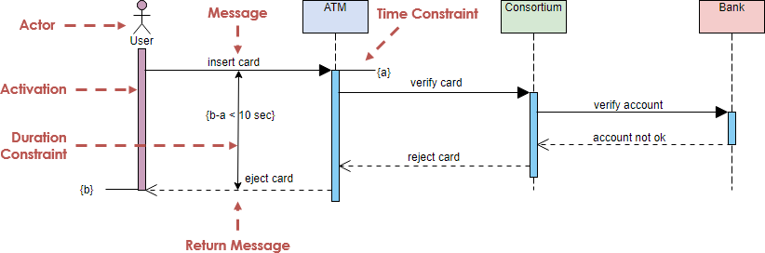
Sequence diagram of use case: enter wrong account information

Slide 23

Sequence diagrams - Example

Slide 24
Sequence diagrams - Example

Slide 25
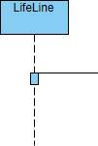
Sequence diagrams - Example

Slide 26

Sequence diagrams - Example

Slide 27
In-class activity
Draw a sequence diagram

Slide 28
Structural Perspectives

Slide 29
Structural models
Display the organization of a system in terms of the components that make up that system and their relationships.
Structural models may be
static models: show the structure of the system design,
or dynamic models: show the organization of the system when it is executing.
Create structural models of a system when discussing and designing the system architecture.
Notes:
You create structural models of a system when you are discussing and designing the system architecture. Architectural design is a particularly important topic in software
engineering and UML component, package, and deployment diagrams may all be used when presenting architectural models.

Slide 30
Class diagrams
https://online.visual-paradigm.com/diagrams/tutorials/class-diagram-tutorial/
Used when developing an object-oriented system model to show the classes in a system and the associations between these classes.
An object class can be thought of as a general definition of one kind of system object.
An association is a link between classes that indicates that there is some relationship between these classes.
Notes:
Class diagrams are used when developing an object-oriented system model to show the classes in a system and the associations between these classes.
An object class can be thought of as a general definition of one kind of system object.
An association is a link between classes that indicates that there is some relationship between these classes.
When you are developing models during the early stages of the software engineering process, objects represent something in the real world, such as a patient, a prescription, doctor, etc.
As an implementation is developed, you usually need to define additional implementation objects that are used to provide the required system functionality.

Slide 31
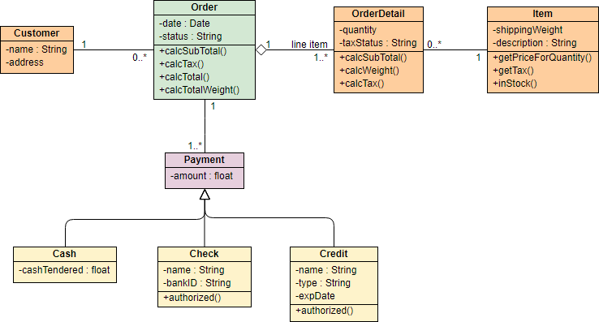
Class diagrams
Notes:
Class diagrams are used when developing an object-oriented system model to show the classes in a system and the associations between these classes.
An object class can be thought of as a general definition of one kind of system object.
An association is a link between classes that indicates that there is some relationship between these classes.
When you are developing models during the early stages of the software engineering process, objects represent something in the real world, such as a patient, a prescription, doctor, etc.
As an implementation is developed, you usually need to define additional implementation objects that are used to provide the required system functionality.

Slide 32
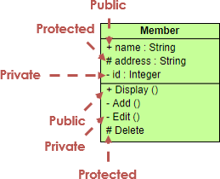
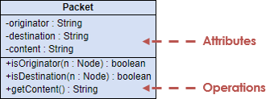
Class diagrams
Class
Attributes
Operations
Notes:
Class diagrams are used when developing an object-oriented system model to show the classes in a system and the associations between these classes.
An object class can be thought of as a general definition of one kind of system object.
An association is a link between classes that indicates that there is some relationship between these classes.
When you are developing models during the early stages of the software engineering process, objects represent something in the real world, such as a patient, a prescription, doctor, etc.
As an implementation is developed, you usually need to define additional implementation objects that are used to provide the required system functionality.

Slide 33


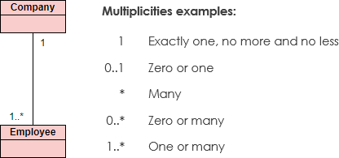
Class diagrams - Relationships
Notes:
Class diagrams are used when developing an object-oriented system model to show the classes in a system and the associations between these classes.
An object class can be thought of as a general definition of one kind of system object.
An association is a link between classes that indicates that there is some relationship between these classes.
When you are developing models during the early stages of the software engineering process, objects represent something in the real world, such as a patient, a prescription, doctor, etc.
As an implementation is developed, you usually need to define additional implementation objects that are used to provide the required system functionality.

Slide 34
Class diagrams - Relationships
Notes:
Class diagrams are used when developing an object-oriented system model to show the classes in a system and the associations between these classes.
An object class can be thought of as a general definition of one kind of system object.
An association is a link between classes that indicates that there is some relationship between these classes.
When you are developing models during the early stages of the software engineering process, objects represent something in the real world, such as a patient, a prescription, doctor, etc.
As an implementation is developed, you usually need to define additional implementation objects that are used to provide the required system functionality.

Slide 35
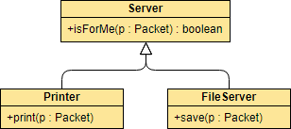
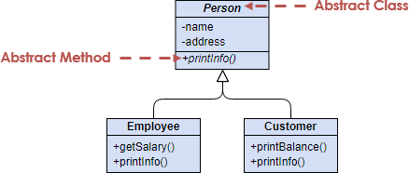
Class diagrams - Generalization
Notes:
Class diagrams are used when developing an object-oriented system model to show the classes in a system and the associations between these classes.
An object class can be thought of as a general definition of one kind of system object.
An association is a link between classes that indicates that there is some relationship between these classes.
When you are developing models during the early stages of the software engineering process, objects represent something in the real world, such as a patient, a prescription, doctor, etc.
As an implementation is developed, you usually need to define additional implementation objects that are used to provide the required system functionality.

Slide 36
Database diagrams vs class diagrams
Entity/Relation/Table vs. class
Entity/Relation/Table relationship vs class relationship
When and why we need
Only database
Only classes
Both

Slide 37
behavioral perspectives

Slide 38
Behavioral models
Behavioral models are models of the dynamic behavior of a system as it is executing.
They show what happens or what is supposed to happen when a system responds to a stimulus from its environment.
Stimuli:
Data: Some data arrives that has to be processed by the system.
Events: Some event happens that triggers system processing. Events may have associated data, although this is not always the case.
Notes:
Behavioral models are models of the dynamic behavior of a system as it is executing. They show what happens or what is supposed to happen when a system responds to a stimulus from its environment.
You can think of these stimuli as being of two types:
Data Some data arrives that has to be processed by the system. For example, a phone billing system will accept information about calls made by a customer, calculate the costs of these calls, and generate a bill to be sent to that customer
Events Some event happens that triggers system processing. Events may have associated data, although this is not always the case. For example, a landline phone switching system responds to events such as ‘receiver off hook’ by generating a dial tone, or the pressing of keys on a handset by capturing the phone number, etc.

Slide 39
Data-driven modeling
Many business systems are data-processing systems that are primarily driven by data. They are controlled by the data input to the system, with relatively little external event processing.
Data-driven models show the sequence of actions involved in processing input data and generating an associated output.
Data-Flow-Diagrams ( DFD) ?
Not UML
Notes:
Many business systems are data-processing systems that are primarily driven by data. They are controlled by the data input to the system, with relatively little external event processing.
Data-driven models show the sequence of actions involved in processing input data and generating an associated output.
They are particularly useful during the analysis of requirements as they can be used to show end-to-end processing in a system.

Slide 40
An activity model of the insulin pump’s operation
Notes:
Data-driven model: the chain of processing involved in the insulin pump software: the processing steps (represented as activities) and the data flowing between these steps (represented as objects).

Slide 41
Order processing – An alternative to represent behaviors
Notes:
A sequence model of the processing of an order and sending it to a supplier. Sequence models highlight objects in a system, whereas data-flow diagrams highlight the functions. The equivalent data-flow diagram for order processing is shown on the book’s web pages.

Slide 42
Event-driven modeling
Real-time systems are often event-driven, with minimal data processing. For example, a landline phone switching system responds to events such as ‘receiver off hook’ by generating a dial tone.
Event-driven modeling shows how a system responds to external and internal events.
It is based on the assumption that a system has a finite number of states and that events (stimuli) may cause a transition from one state to another.
Notes:
Real-time systems are often event-driven, with minimal data processing. For example, a landline phone switching system responds to events such as ‘receiver off hook’ by generating a dial tone.
Event-driven modeling shows how a system responds to external and internal events.
It is based on the assumption that a system has a finite number of states and that events (stimuli) may cause a transition from one state to another.
State machine models
These model the behaviour of the system in response to external and internal events.
They show the system’s responses to stimuli so are often used for modelling real-time systems.
State machine models show system states as nodes and events as arcs between these nodes. When an event occurs, the system moves from one state to another.
Statecharts are an integral part of the UML and are used to represent state machine models.

Slide 43
State diagram of a microwave oven
Notes:
This state diagram of a microwave oven based on the following assumption: the sequence of actions in using the microwave is:
1. Select the power level (either half power or full power).
2. Input the cooking time using a numeric keypad.
3. Press Start and the food is cooked for the given time.
UML state diagrams notation:
States: rounded rectangles, may include a brief description (following ‘do’) of the actions taken in that state
Stimuli: labeled arrows, force a transition from one state to another.
Start/end state: filled/filled with double line circles (as in activity diagrams)

Slide 44
Microwave oven operation
Superstate encapsulates a number of separate states.
looks like a single state on a high-level model
expanded to show more detail on a separate diagram.
Notes:
The number of possible states increases rapidly => for large system models, detail is hiden by using the notion of a superstate that encapsulates a number of separate states.
This superstate looks like a single state on a high-level model but is then expanded to show more detail on a separate diagram.
For example, the Operation state can be expanded to includes Checking, Cook, Alarm and Done states.

Slide 45
States and stimuli for the microwave oven
State | Description
Waiting | The oven is waiting for input. The display shows the current time.
Half power | The oven power is set to 300 watts. The display shows ‘Half power’.
Full power | The oven power is set to 600 watts. The display shows ‘Full power’.
Set time | The cooking time is set to the user’s input value. The display shows the cooking time selected and is updated as the time is set.
Disabled | Oven operation is disabled for safety. Interior oven light is on. Display shows ‘Not ready’.
Enabled | Oven operation is enabled. Interior oven light is off. Display shows ‘Ready to cook’.
Operation | Oven in operation. Interior oven light is on. Display shows the timer countdown. On completion of cooking, the buzzer is sounded for five seconds. Oven light is on. Display shows ‘Cooking complete’ while buzzer is sounding.

Slide 46
States and stimuli for the microwave oven (cont.)
Stimulus | Description
Half power | The user has pressed the half-power button.
Full power | The user has pressed the full-power button.
Timer | The user has pressed one of the timer buttons.
Number | The user has pressed a numeric key.
Door open | The oven door switch is not closed.
Door closed | The oven door switch is closed.
Start | The user has pressed the Start button.
Cancel | The user has pressed the Cancel button.

Slide 47
Summary
A model is an abstract view of a system
Context models show how a system is positioned in an environment with other systems and processes.
Use case diagrams and sequence diagrams are used to describe the interactions between users and systems in the system
Use cases describe interactions between a system and external actors;
Sequence diagrams add more information to these by showing interactions between system objects.
Structural models show the organization and architecture of a system.
Class diagrams are used to define the static structure of classes in a system and their associations.
Notes:
A model is an abstract view of a system that ignores system details. Complementary system models can be developed to show the system’s context, interactions, structure and behavior.
Context models show how a system that is being modeled is positioned in an environment with other systems and processes.
Use case diagrams and sequence diagrams are used to describe the interactions between users and systems in the system being designed. Use cases describe interactions between a system and external actors; sequence diagrams add more information to these by showing interactions between system objects.
Structural models show the organization and architecture of a system. Class diagrams are used to define the static structure of classes in a system and their associations.

Slide 48
Summary (cont.)
Behavioral models are used to describe the dynamic behavior of an executing system.
Can be by the perspective of the data processed by the system, or by the events that stimulate responses from a system.
Activity diagrams may be used to model the processing of data, where each activity represents one process step.
State diagrams are used to model a system’s behavior in response to internal or external events.
Notes:
Behavioral models are used to describe the dynamic behavior of an executing system. This behavior can be modeled from the perspective of the data processed by the system, or by the events that stimulate responses from a system.
Activity diagrams may be used to model the processing of data, where each activity represents one process step.
State diagrams are used to model a system’s behavior in response to internal or external events.

Slide 49
More on UML
Self-study

Slide 50
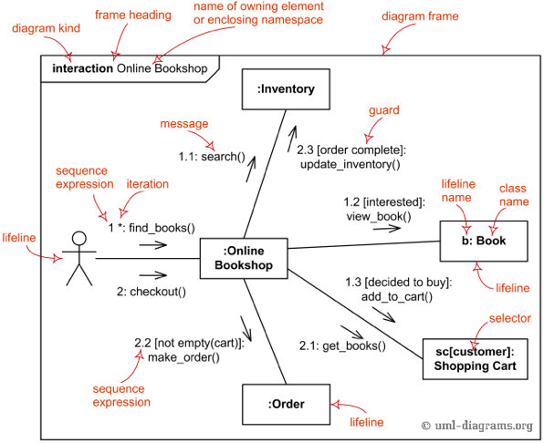
Collaboration / Communication diagrams
Notes:
Communication diagram (collaboration diagram in UML 1.x)
show interactions between objects and/or parts (represented as lifelines) using sequenced messages in a free-form arrangement.
Communication diagram corresponds (i.e. could be converted to/from or replaced by) to a simple sequence diagram without structuring mechanisms such as interaction uses and combined fragments.

Slide 51
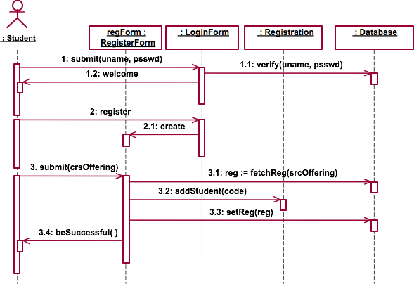
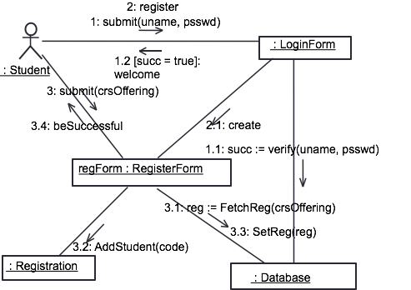
Sequence vs. collaboration diagrams
Notes:
Sequence diagrams and collaboration diagrams are equivalent, but provide different views.
Sequence diagrams focus on the sequence of actions. It is hard to see the collaboration between any two components in a large sequence diagram.
Collaboration diagrams focus on the collaboration among components. The numbered arrows will show the order of actions.
There is some tool which convert between sequence diagrams and collaboration diagrams.

Slide 52
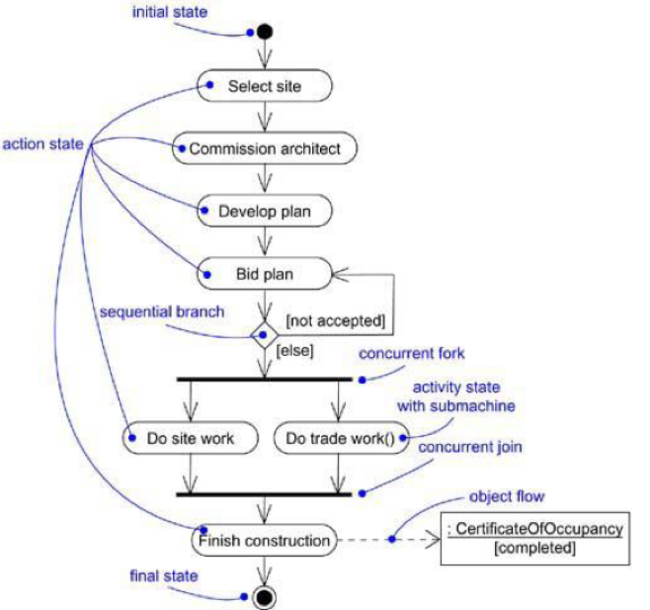
Activity diagrams
Notes:
An activity diagram is a special kind of a statechart diagram that shows the flow from activity to activity within a system.
Focuses on activities

Slide 53
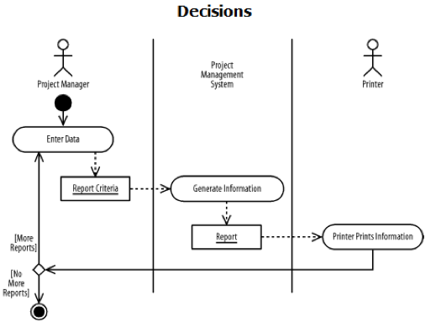
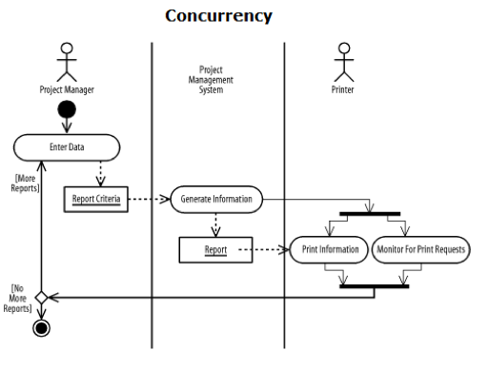
Activity diagrams (cont.)
Swimming lane
Notes:
When some activities are assigned to some actor/system, swimming lane can be use to divide the diagram into separated areas
A decision can be represented by a diamond
Concurrency can be represented by a solid bar at the beginning and at the end of the concurrency. All activities in between the bars are performed concurrently.

